Slide 1
Data Prep Kit (DPK) & InstructLab Introduction

Slide 2
Agenda
Introduction
Utilities
Reason for use
The Parquet format
InstructLab

Slide 3
Introduction
Data Prep Kit is a toolkit that helps developers streamline data preparation.
It is used in building LLM-enabled applications using
fine-tuning,
RAG,
instruction-tuning, or
agentic techniques.
Reference – https://developer.ibm.com/learningpaths/get-started-data-prep-kit/dpk-intro/

Slide 4
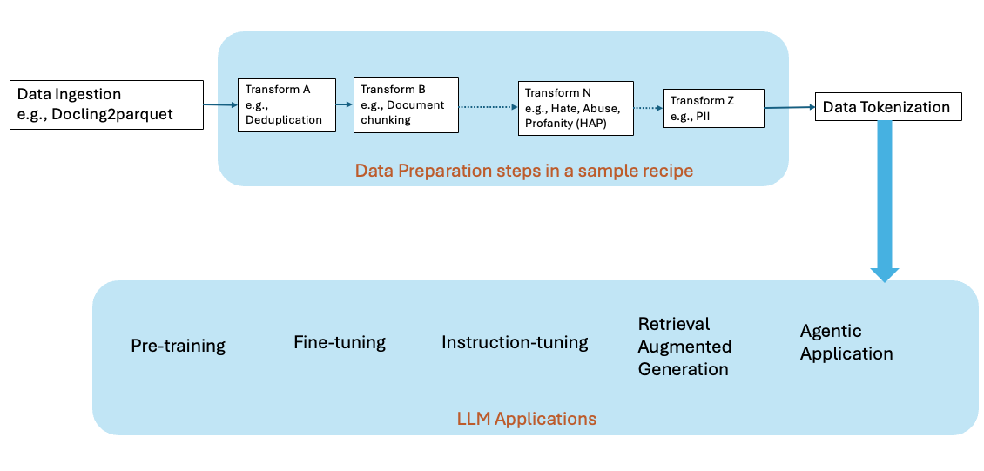
AI development lifecycle while adding own domain data
Reference - https://developer.ibm.com/learningpaths/get-started-data-prep-kit/dpk-intro/

Slide 5
Utilities
We can use the Data Prep Kit modules to easily build data pipelines that best supports our case.
DPK modules, also referred to as transforms, help the developer
Get started and build end-to-end data pipelines, from ingestion to tokenization, that fit their use cases.
These modules have been used to produce pre-training data sets for the Granite open models on HuggingFace.
Reference – https://developer.ibm.com/learningpaths/get-started-data-prep-kit/dpk-intro/

Slide 6
Reason for use
The Challenging aspect of building AI workloads
Volume of data
Complexity of the data
Every use case has its own unique needs and manual verification of the data quality is not possible due to the huge data volumes.
Reference – https://developer.ibm.com/learningpaths/get-started-data-prep-kit/dpk-intro/

Slide 7
Reason for use (contd.)
The Solution is the open-source Data Prep Kit (DPK) with a friendly Apache 2.0 license.
DPK currently consists of 25+ modules for pre-processing data for code and language.
These modules provide a comprehensive set of capabilities for
ingestion,
document annotation,
filtering, and
redaction of private information.
Reference – https://developer.ibm.com/learningpaths/get-started-data-prep-kit/dpk-intro/

Slide 8
The Parquet format
A brief introduction

Slide 9
Parquet format – What is it?
Parquet is a columnar storage file format
It is primarily used with big data processing tools like Apache Spark, Hive, and Pandas.
It was developed by Apache as part of the Hadoop ecosystem but is now widely supported across many platforms.

Slide 10
Key Features of Parquet Format
Columnar Storage:
Stores data column by column rather than row by row.
Efficient for analytics and queries that access only a subset of columns.
Highly Efficient Compression:
Better compression than row-based formats (like CSV) because similar data types are stored together.
Reduces storage costs and improves I/O performance.

Slide 11
Key Features of Parquet Format
Schema-Based:
Self-describing files with embedded schema information.
Makes it easier for tools to interpret the data structure.
Supports Complex Data Types:
Can store nested data structures like arrays, structs, and maps.
Interoperable:
Compatible with various languages and data processing frameworks (Python, Java, R, Spark, etc.).

Slide 12
Examples
Compared to a CSV file:
CSV: Row-based, inefficient for large analytical queries, no schema.
Parquet: Columnar, compressed, schema-aware, optimized for performance.

Slide 13
Visual Example
Suppose we have a table like below:
ID | Name | Age | Country
1 | Alice | 25 | USA
2 | Bob | 30 | Canada
3 | Cara | 28 | Australia

Slide 14
Visual Example (Contd.)
CSV stores data row by row, like this:
1, Alice, 25, USA
2, Bob, 30, Canada
3, Cara, 28, Australia
Parquet stores data column by column, something like:
Column: ID -> [1, 2, 3]
Column: Name -> [Alice, Bob, Cara]
Column: Age -> [25, 30, 28]
Column: Country -> [USA, Canada, Australia]
This makes operations like “get average age” or “list all countries” much faster, because it doesn’t need to read all the rows—just the relevant column.

Slide 15
InstructLab
A brief introduction

Slide 16
InstructLab – What is it?
InstructLab is a method for training AI models that is meant to significantly improve LLMs used in the development of gen AI applications.
Created by IBM and Red Hat.
InstructLab is named after and based on IBM Research’s work on Large-scale Alignment for chatBots, abbreviated as LAB.
The LAB method is described in a 2024 research paper by members of the MIT-IBM Watson AI Lab and IBM Research.
Reference – https://www.redhat.com/en/topics/ai/what-is-instructlab

Slide 17
InstructLab – Why to use?
Challenges on tweaking pre-trained LLMs to fit specific business needs:
There are limits to how much we can modify these models.
For example, to adjust the parameters and train the open source model Llama 2-70B from Meta.ai, we need approximately 6000 GPUs and we’d need to run the training for about 12 days, which ends up costing approximately $2 million.
Reference – https://www.ibm.com/think/topics/instructlab

Slide 18
InstructLab – Why to use? (Contd.)
Challenges on tweaking pre-trained LLMs to fit specific business needs:
As LLMs continue to grow in size, the feasibility of fully fine-tuning them on consumer hardware becomes increasingly difficult.
The cost of storing and deploying fine-tuned models independently for each task becomes super expensive, as these models maintain the same size as the original retrained model.
LLM refinements typically require large amounts of human-generated data, which can be time-consuming and again gets expensive.
Reference – https://www.ibm.com/think/topics/instructlab

Slide 19
InstructLab – Why to use? (Contd.)
This is where InstructLab steps in.
It provides a solution to the challenges faced by AI practitioners in fine-tuning and deploying LLMs for specific business needs.
It can enhance an LLM using far less human-generated information and far fewer computing resources than are typically used to retrain a model.
And it makes it possible for upstream contributions to continuously make the model better.
Reference – https://www.redhat.com/en/topics/ai/what-is-instructlab

Slide 20
InstructLab – How it works?
InstructLab uses a combination of the following processes:
Taxonomy-driven data curation
taxonomy classifies data samples into smaller groups based on different tasks.
Large-scale synthetic data generation
synthetic data generated for training purposes.
A multi-phased instruction-tuning method
retraining the model using the synthetic data using
a) knowledge tuning & b) skill tuning
Reference – https://developer.ibm.com/articles/awb-instructlab-why-developers-need-it/?utm_source=ibm_developer&utm_content=in_content_link&utm_id=tutorials_awb-contributing-llm-granite-instructlab-ui

Slide 21
Thank you

